Slide 1
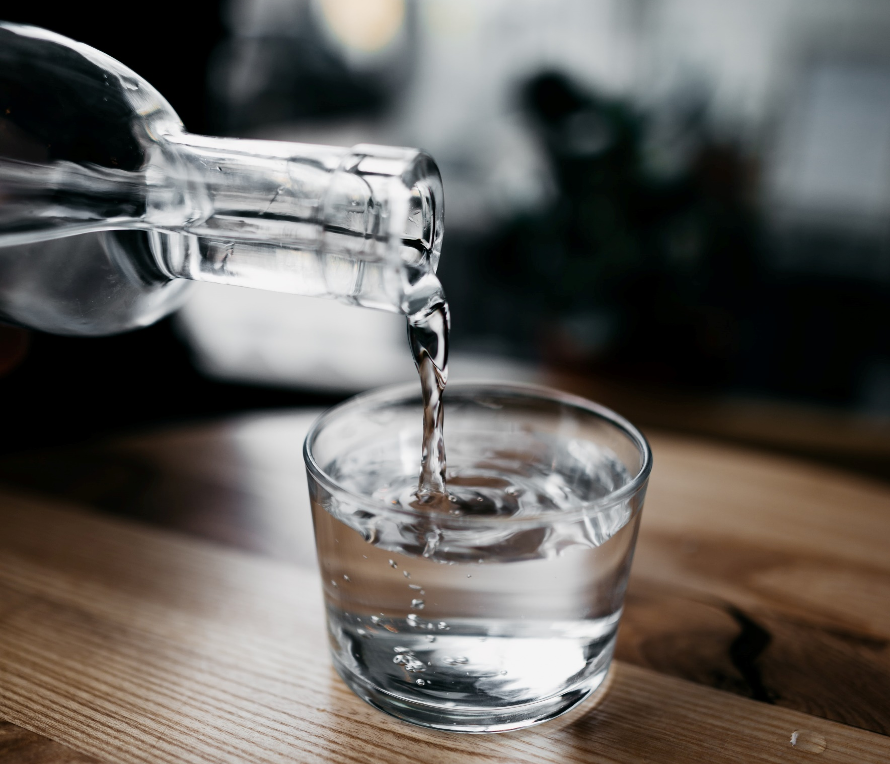
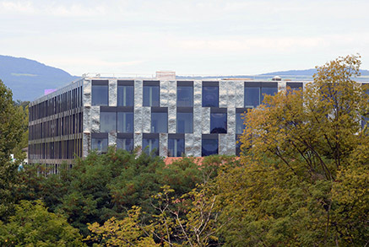
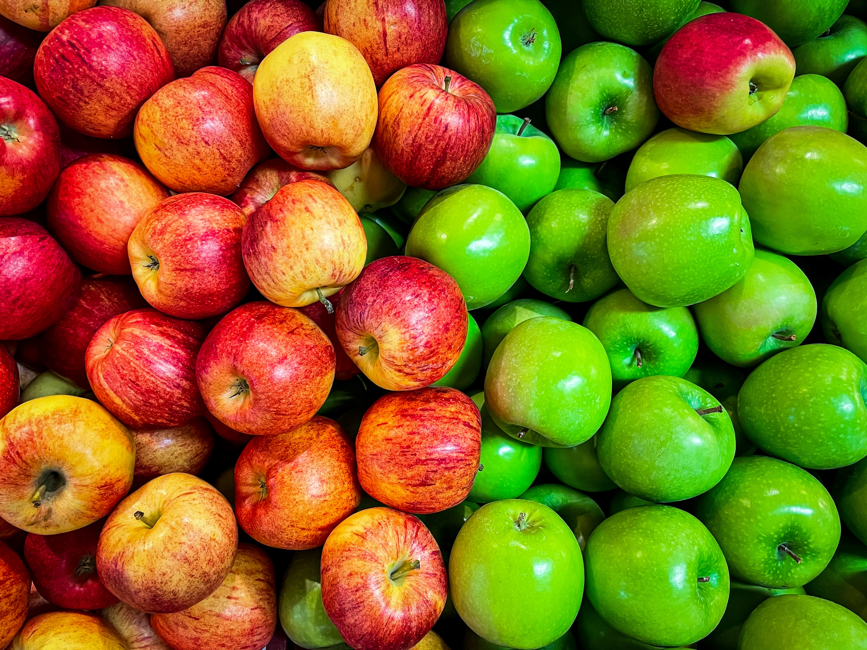
Min 60-75: Break

Slide 2


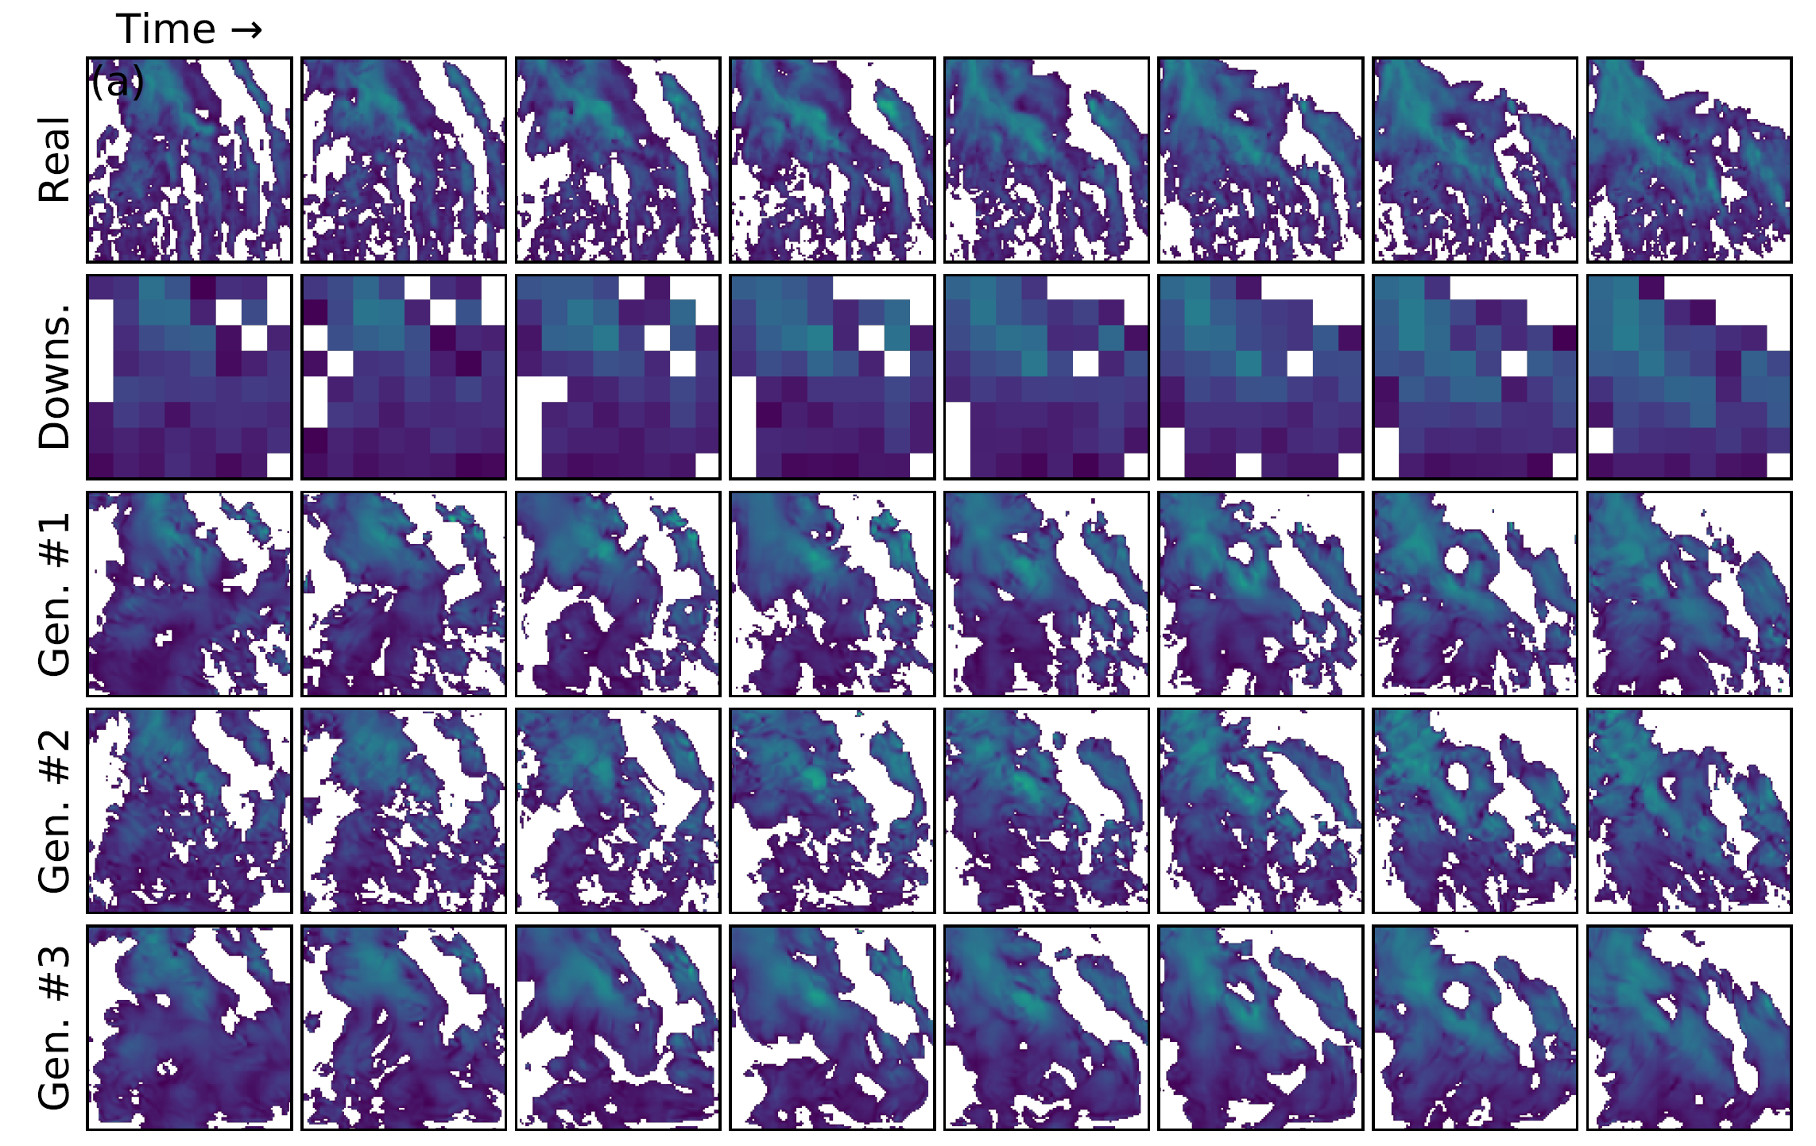
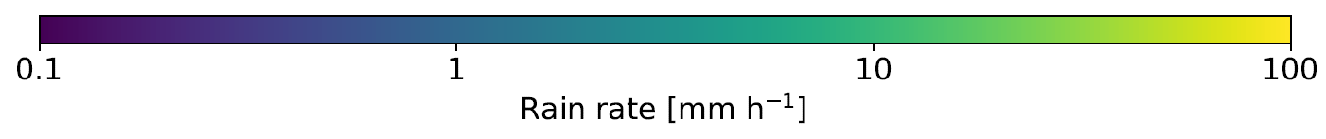
ML for Earth & Env Sci (Week 5, FA2024)
How can we add & evaluate uncertainty in our ML predictions?
Generated rain rates from the downsampled version of the real satellite image
Source: Leinonen et al. (2020)
Notes:
COSERO hydrological model

Slide 3
Mid-term Presentations Wednesday, Nov 6th in Geopolis 2138 (10AM-Noon)
4min presentations + 6min Q&A/feedback
Tip = 1 slide/minute
Scientific question: What’s our goal and why do we care?
Dataset: Characteristics, challenges, training/validation/test split, etc.
Methodology: Which ML algorithm(s) are you planning to use and why?
Results: What are your initial results & what do you plan to do next?

Slide 4
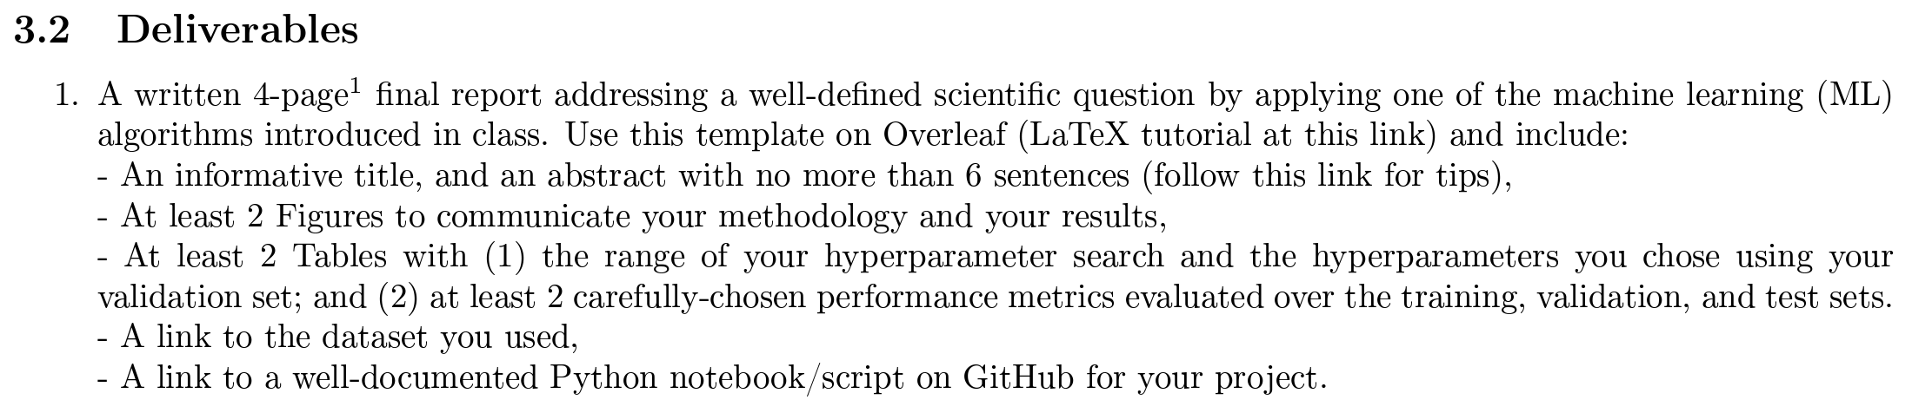
In-class Peer Review: Friday, Dec 6th, 2PM-4PM
Submit first draft of your project by Thursday, Dec 5th

Slide 5
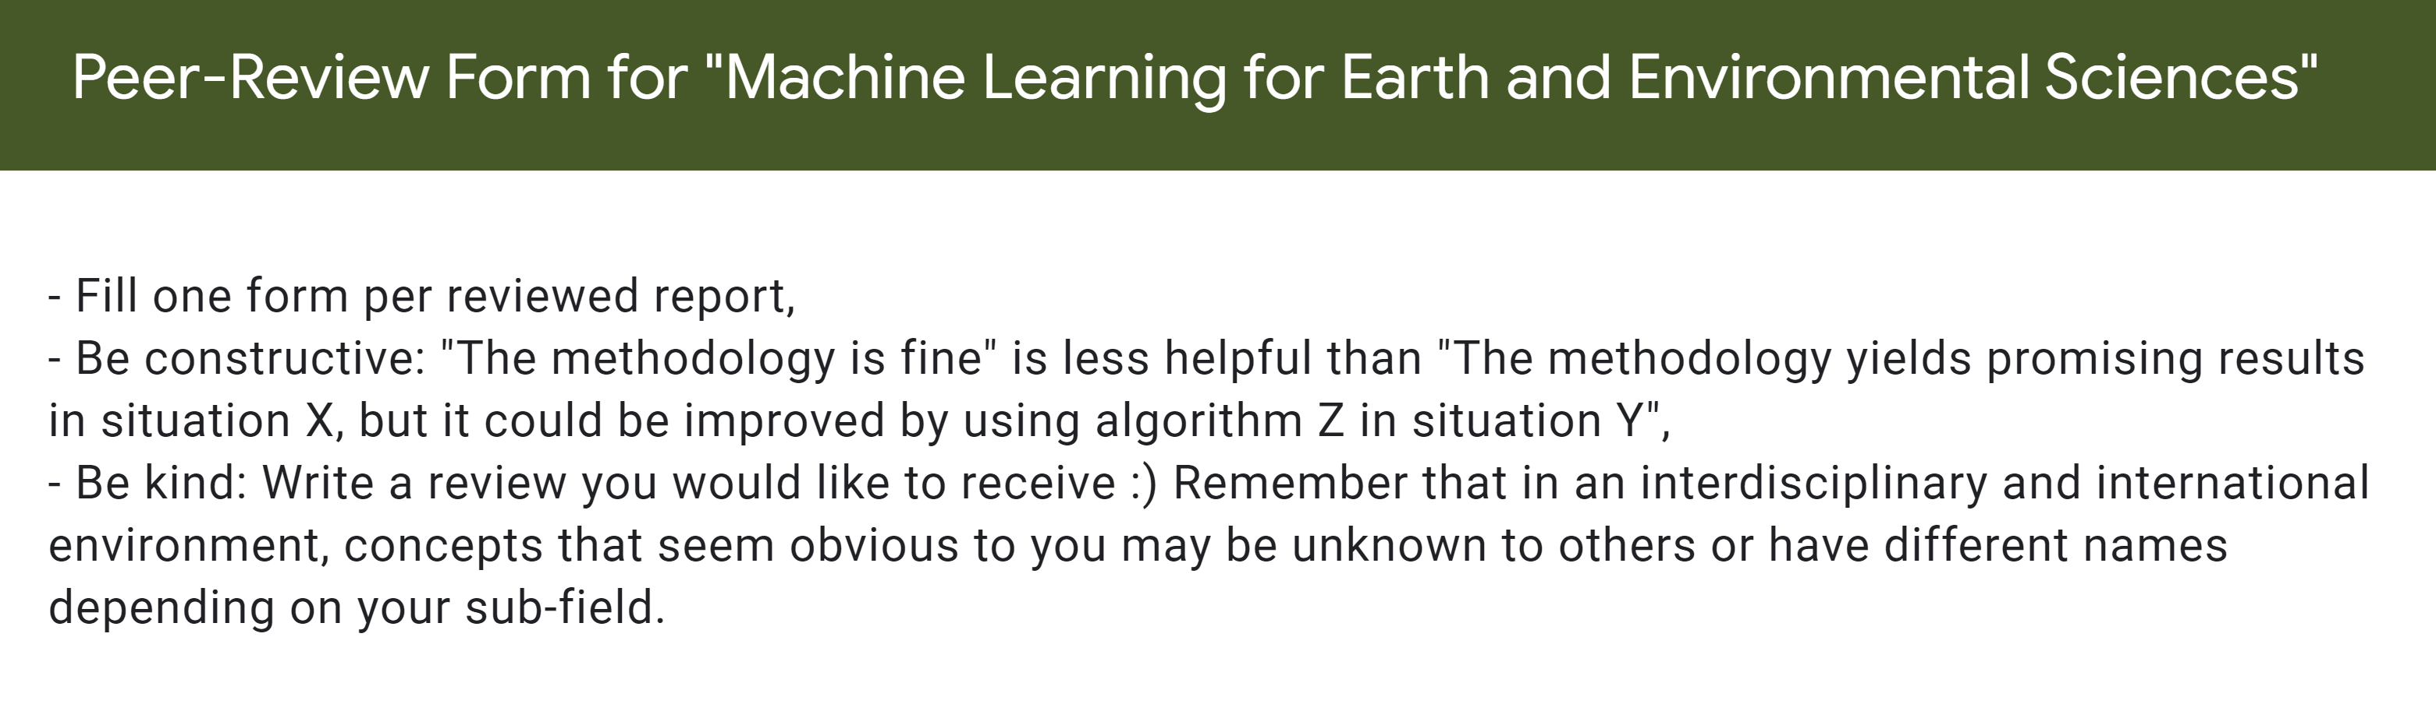
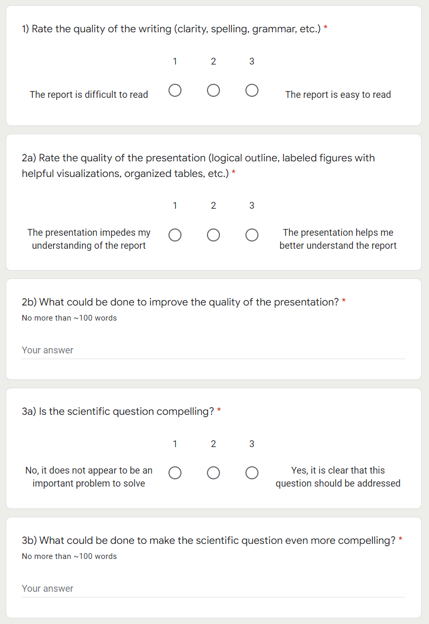
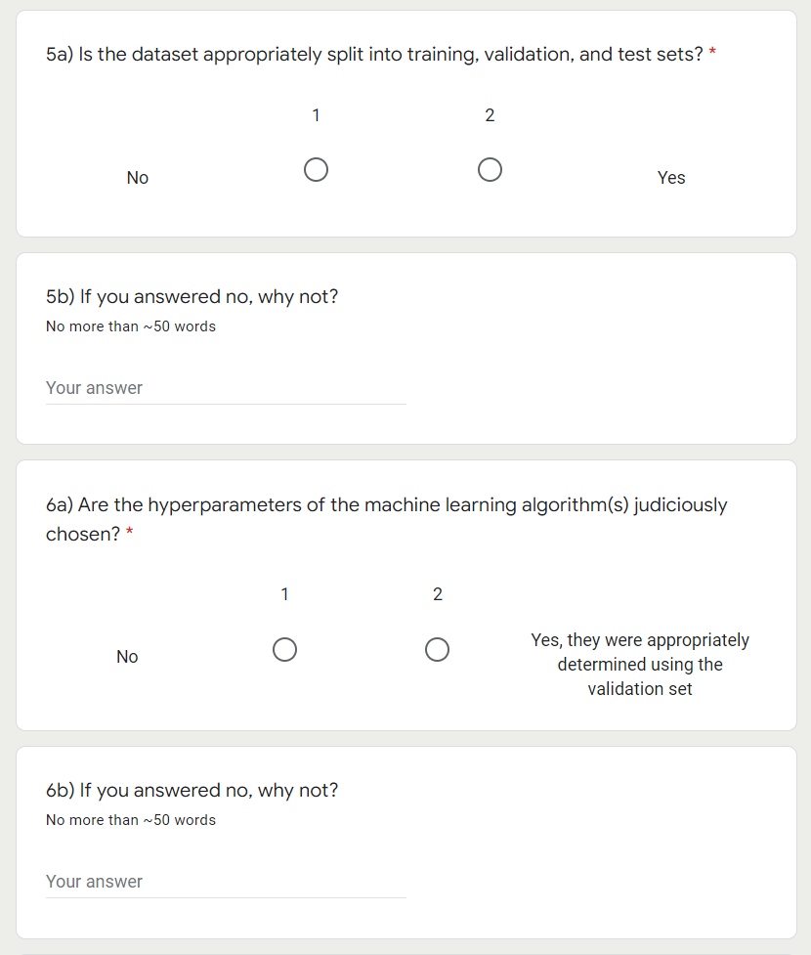

Slide 6
Final Presentations in room 2138 Friday, Dec 13th from 2PM to 4PM
4min presentations + 1min Q&A
Tip = 1 slide/minute
Scientific question: What’s our goal and why do we care?
Dataset: Characteristics, challenges, training/validation/test split, etc.
Methodology: Which ML algorithm(s) did you choose and why?
Results: What are your findings and how does it answer the sci. question?

Slide 7
Min 80-105: Introduction to Generative Modeling
Learning Objectives (Géron Ch17, Haynes et al.):
Define generative modeling
Know different ways of adding uncertainty to ML models
Understand how to evaluate such uncertainty estimates
Know three state-of-the-art generative models
Apprehend applications of latent data representations

Slide 8
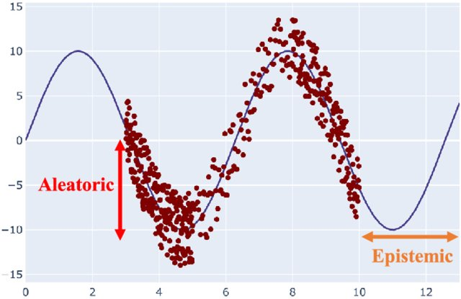
When given an input, generative models predict distributions of outputs rather than a single output vector
Uncertainty Quantification
Stochastic Modeling
Abdar et al. (2021)
Notes:
VOTE: Which uncertainty can be reduced with more data?
VOTE2: Which of the three generated satellite image is most likely?

Slide 9
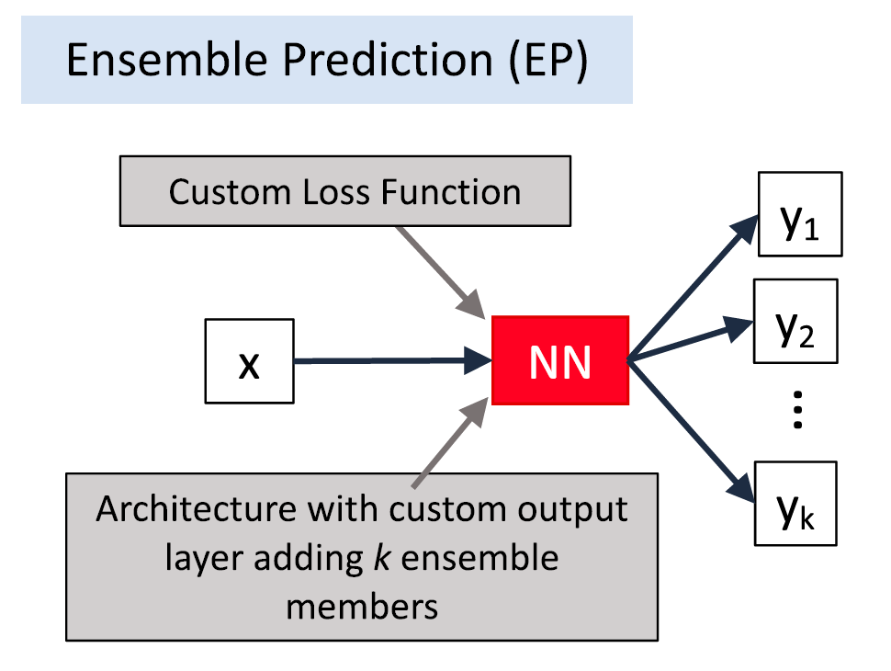
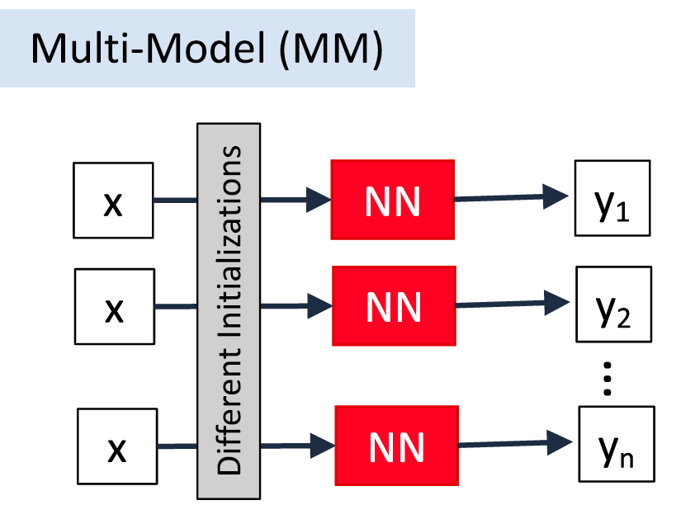
In practice, there are many ways of adding UQ!
Haynes et al. (2023)
Notes:
Emphasize “smart error bounds” because they are state-dependent

Slide 10
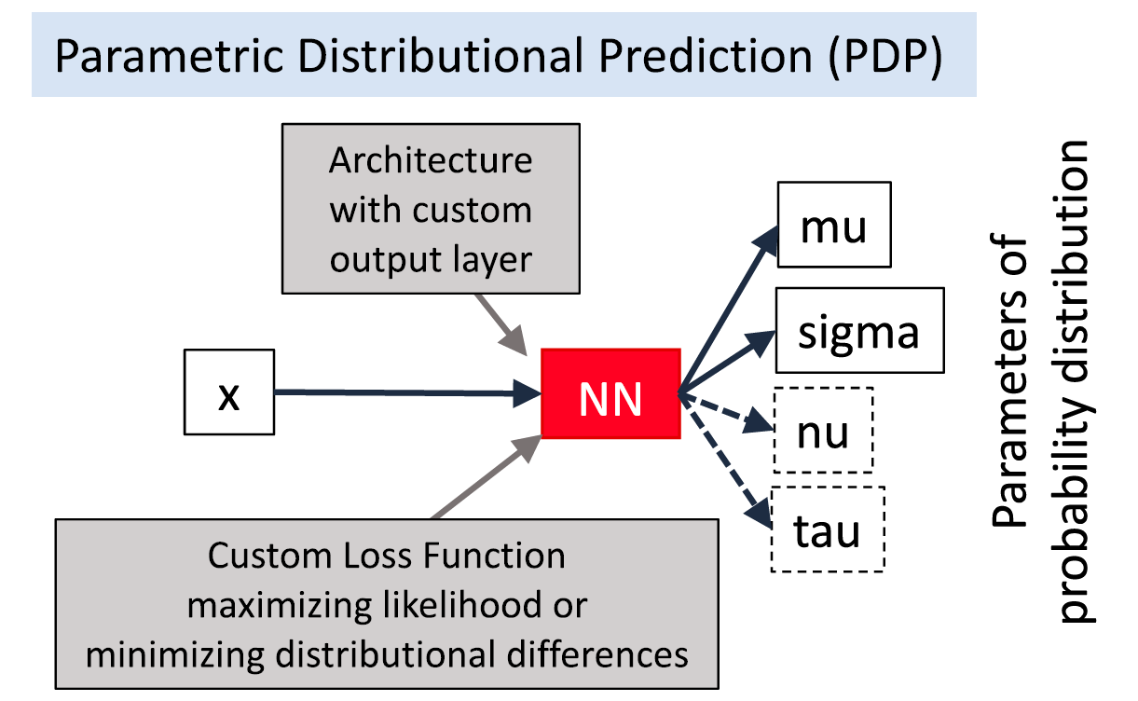
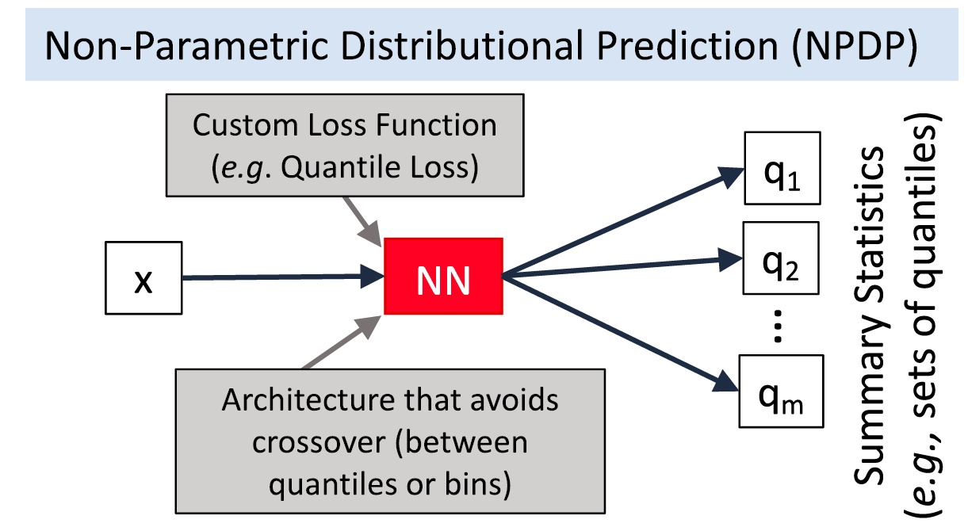
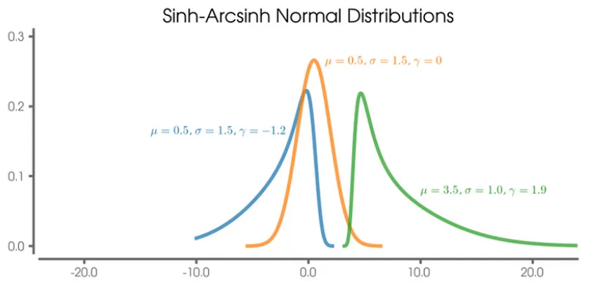
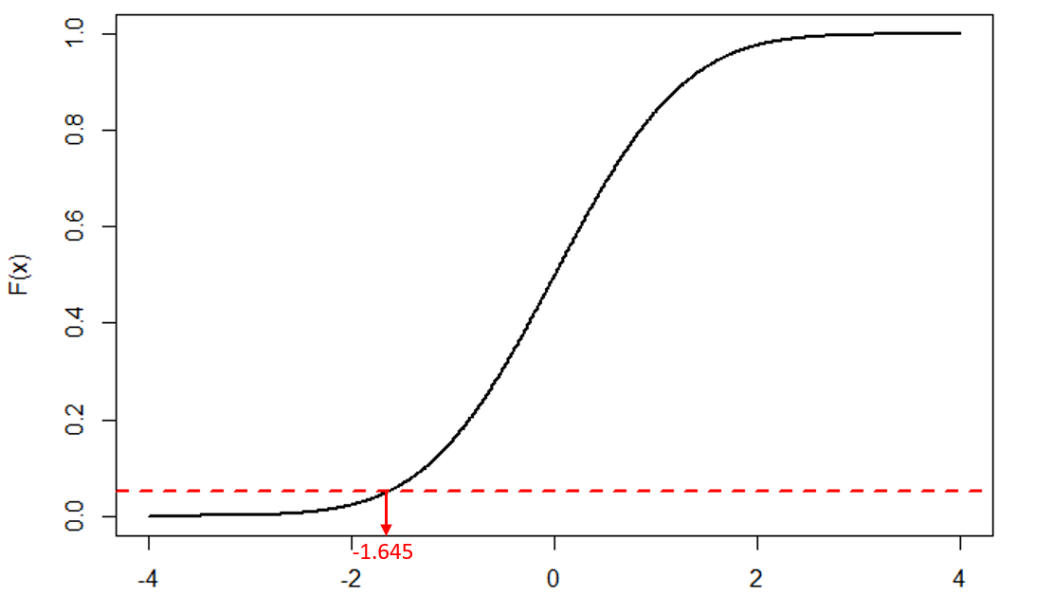
In practice, there are many ways of adding UQ!
Haynes et al. (2023). Kujawska et al. (2021)
Notes:
VOTE: Can you think of other methods?

Slide 11
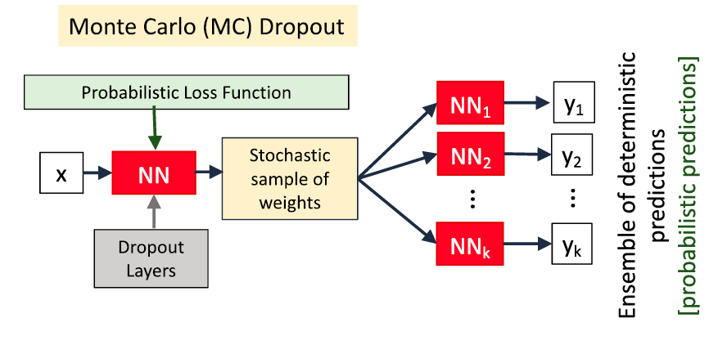
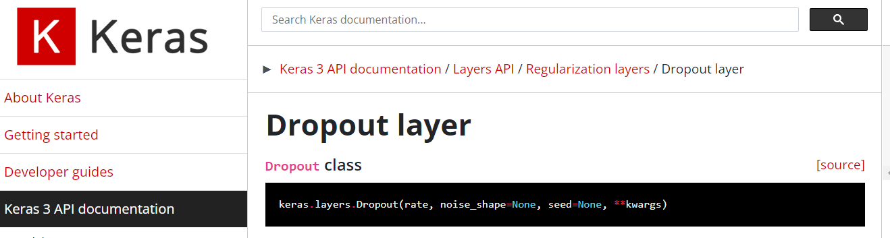
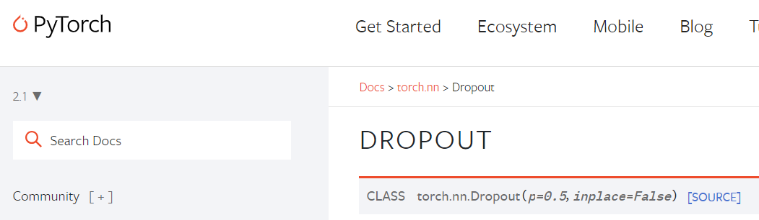
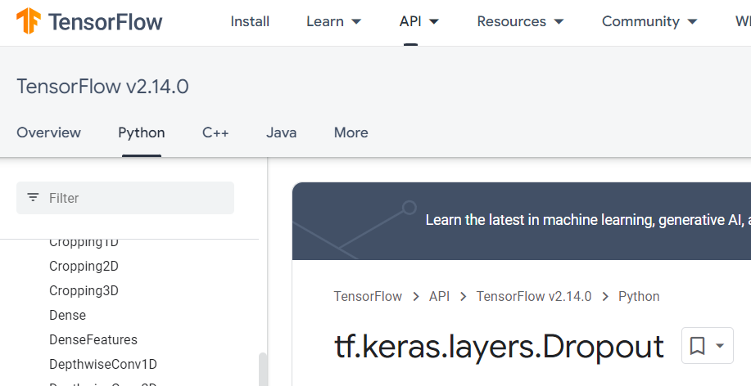
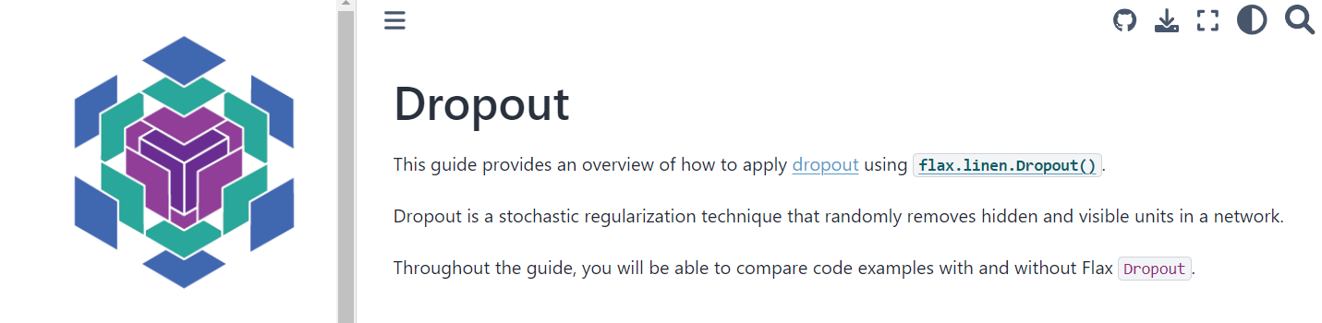
MC-Dropout randomly drops neural connections (Training) Regularization & (Test time) UQ

Slide 12
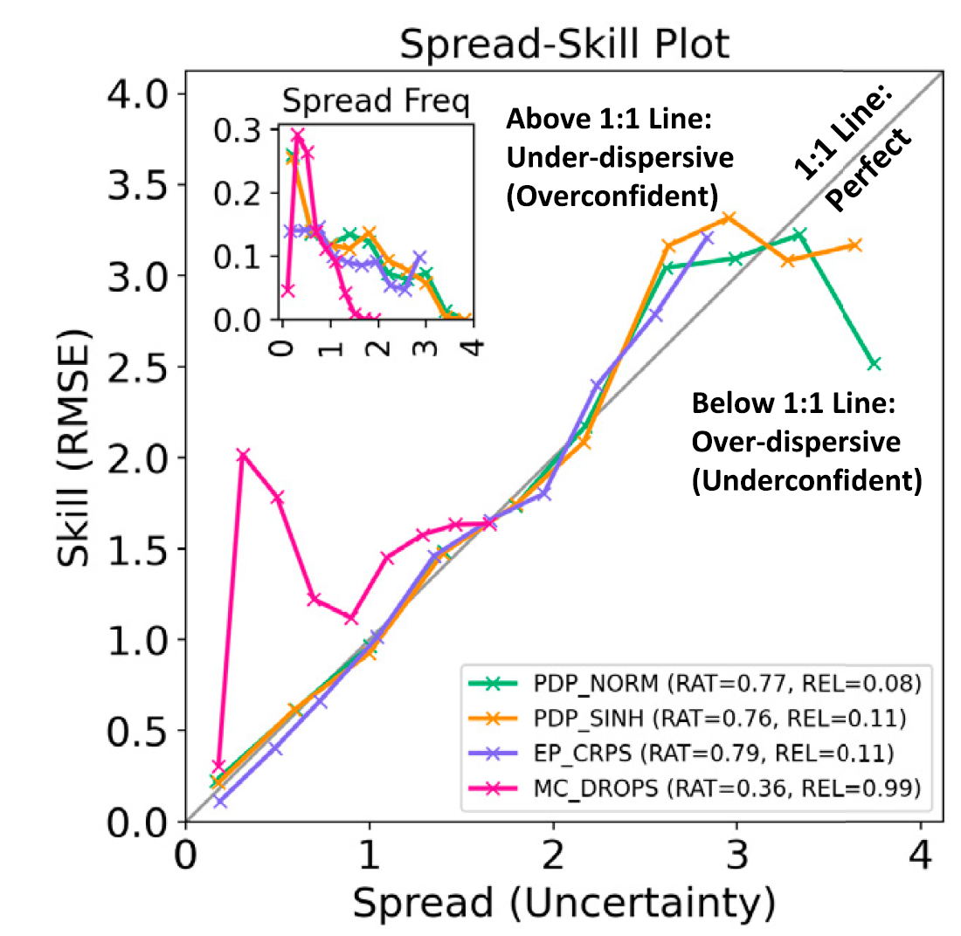
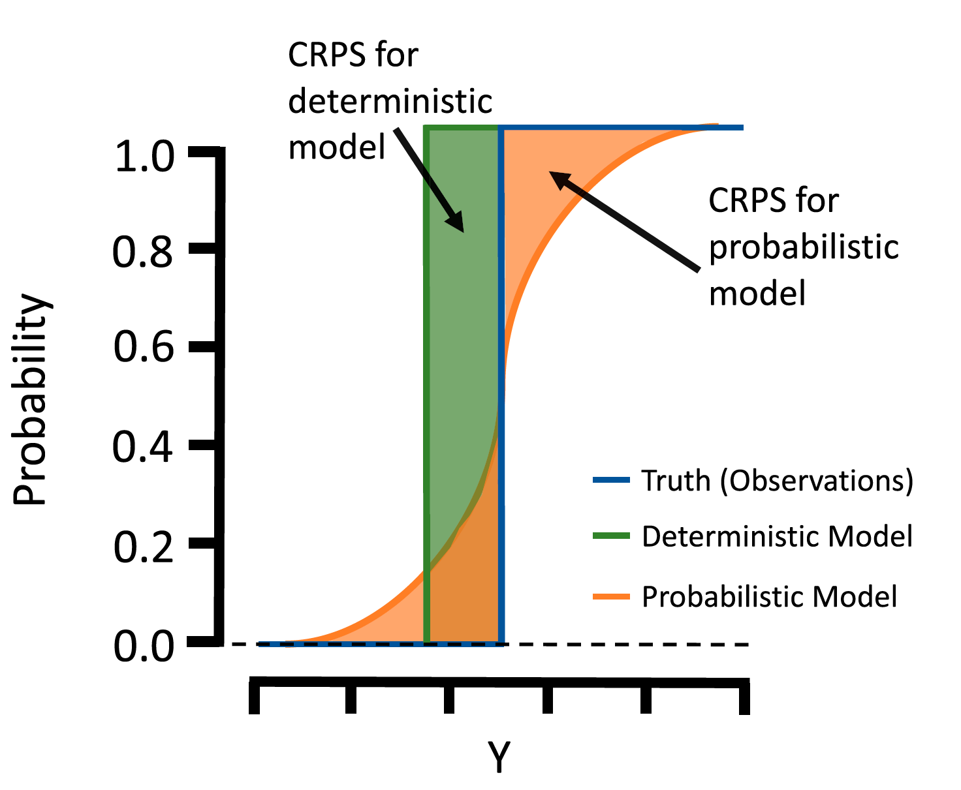
Spread-Skill Plot and CRPS* evaluate the generated distribution *(Continuous Ranked Prob. Score)
Notes:
But now how can we evaluate it? Build intuition with simple case.

Slide 13
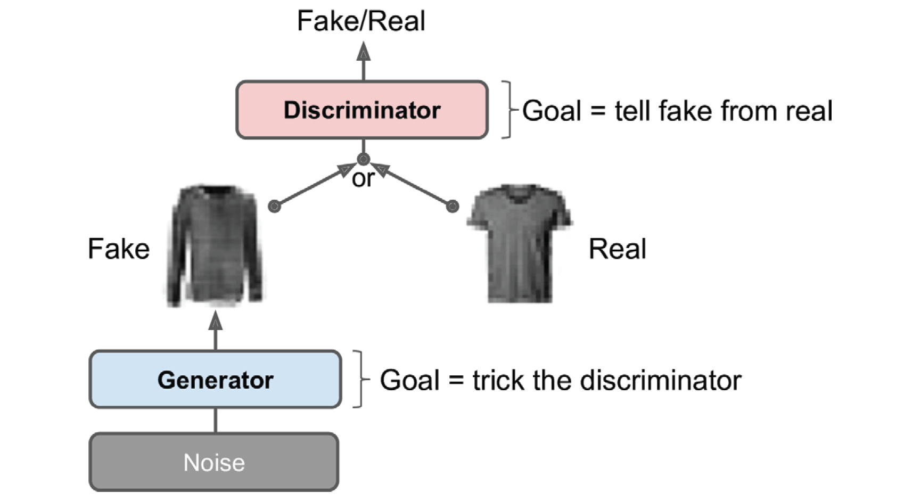
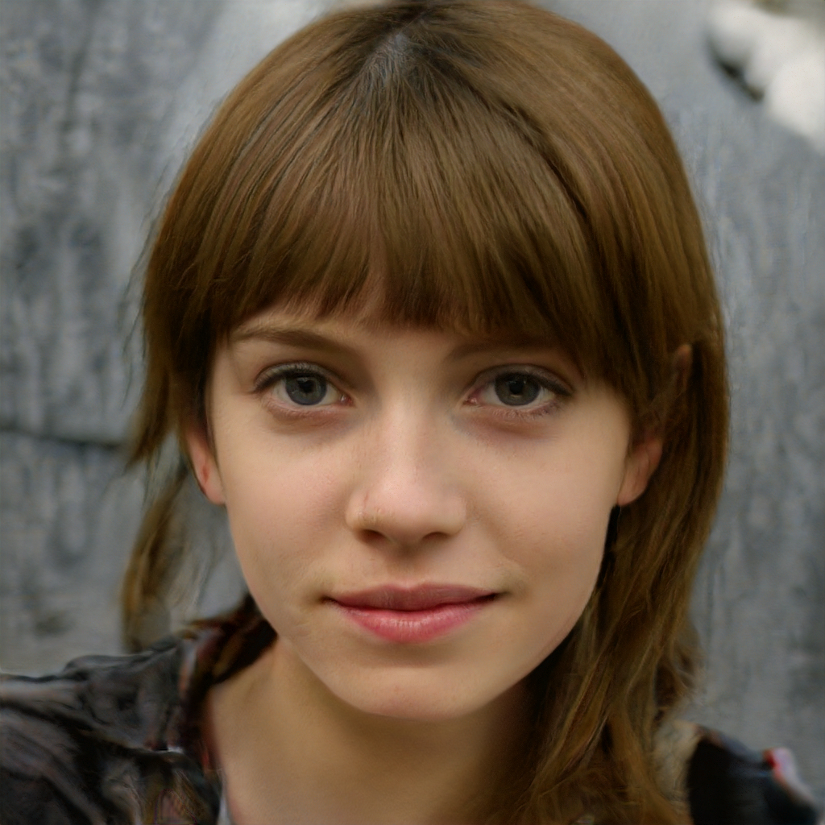
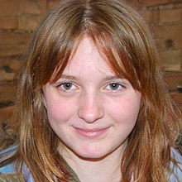
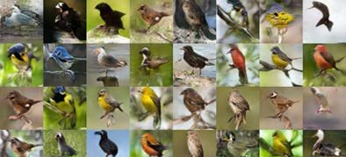
1) Generative Adversarial Nets pit a generator (fed noise) against a discriminator (fed the fake or real images)
Géron textbook, Wikipedia (GAN), Bodla et al. (2018)
Notes:
Know three state-of-the-art generative models

Slide 14
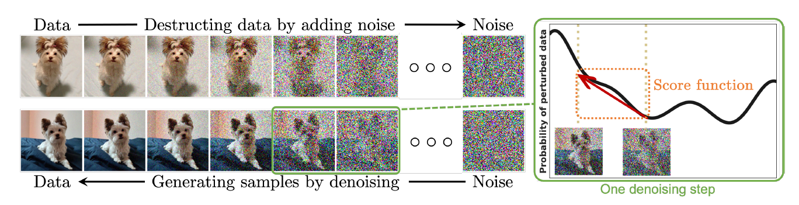
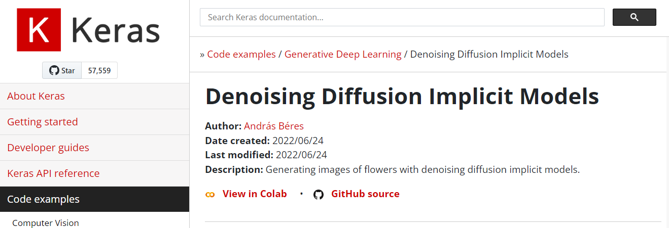
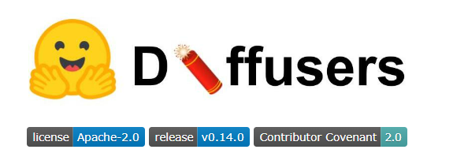
2) Diffusion Probabilistic Models smoothly perturb data by adding noise, then reverse this process to generate new data from noise.
Yang et al. (2022)

Slide 15
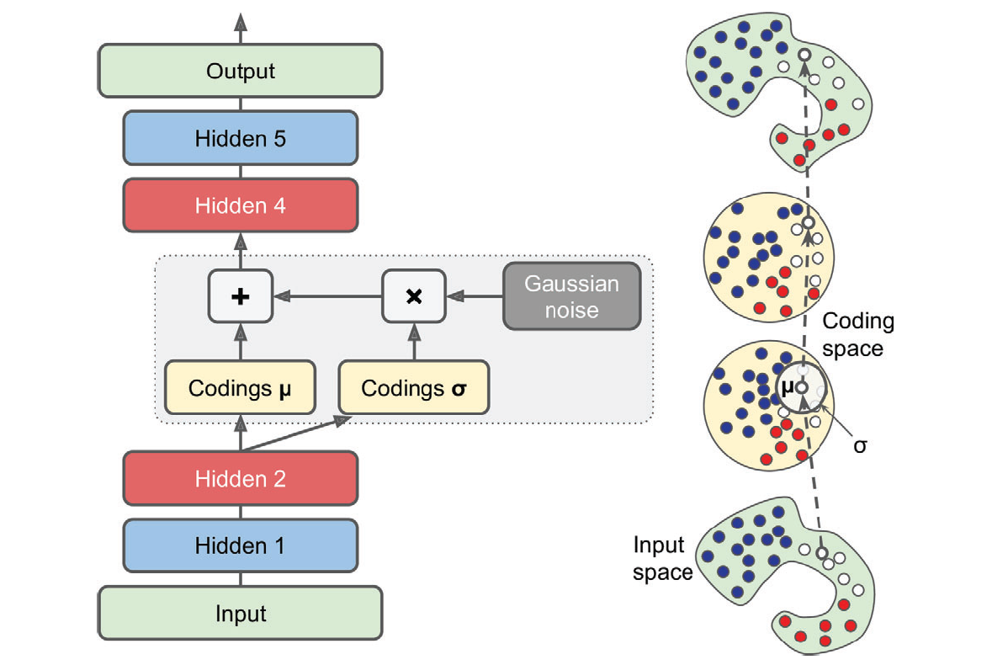
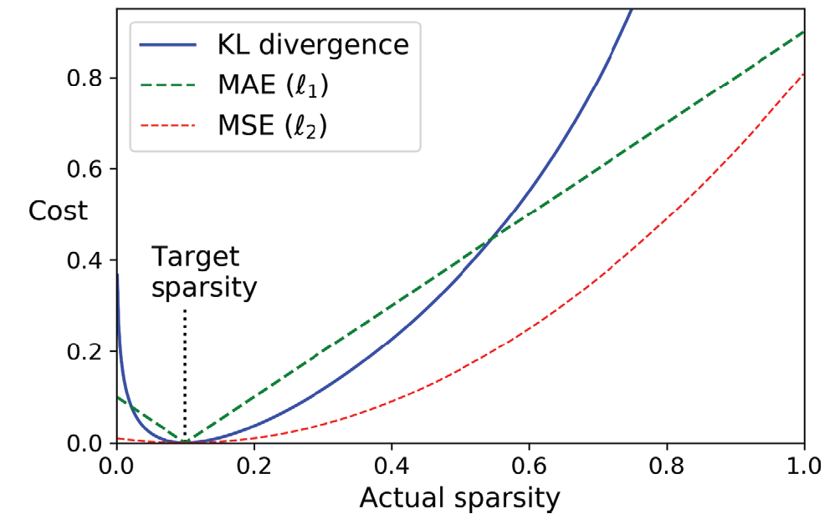
3) Variational Autoencoders probabilistically encode/decode data from latent representations

Slide 16
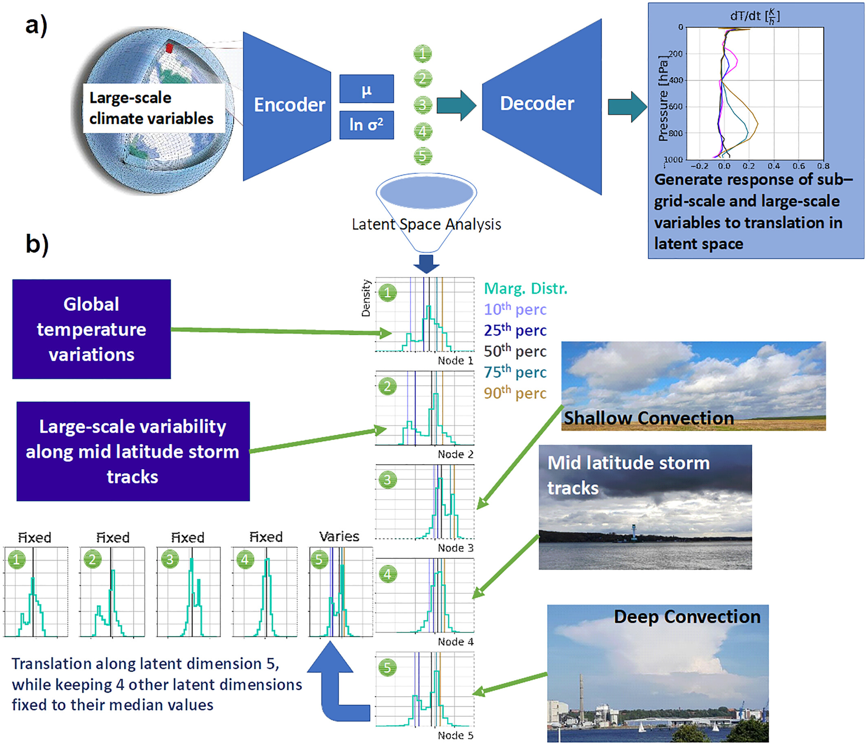
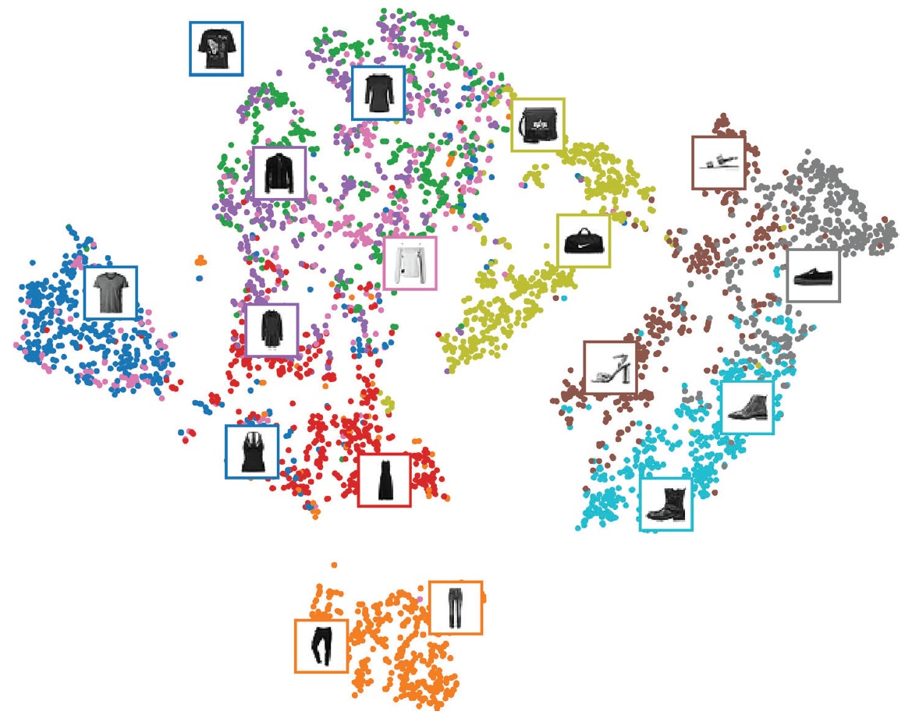
Latent manifold or “Latent space”
Géron textbook, Behrens et al. (2022)

Slide 17
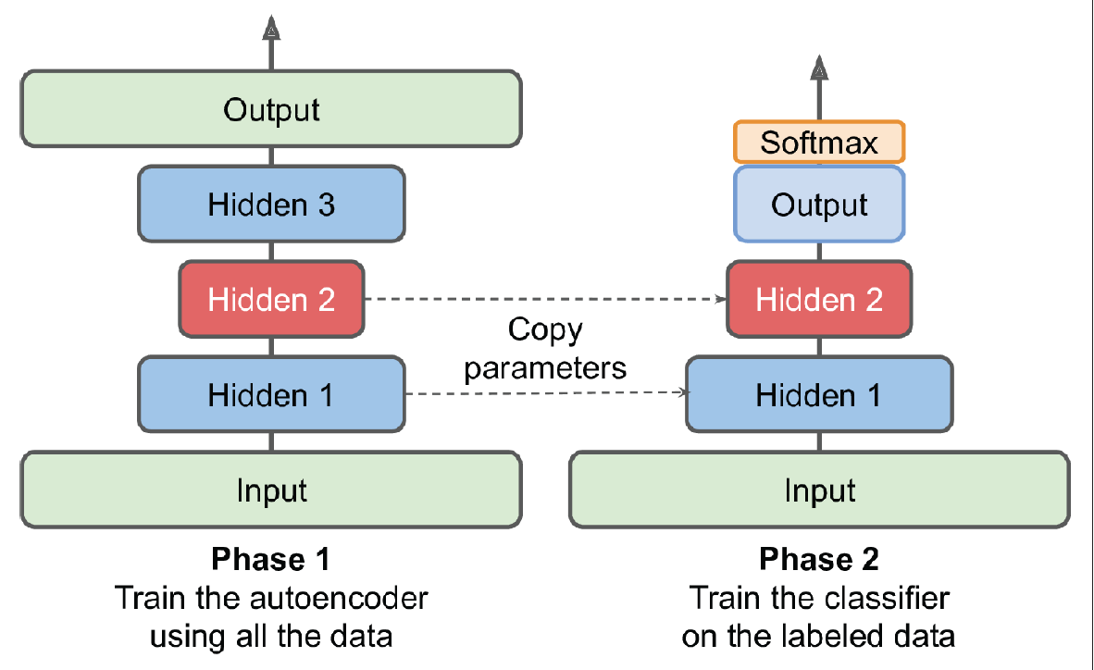
Latent manifolds can be used for e.g., scientific analysis and semi-supervised learning

Slide 18
Mid-term Presentations Friday, Nov 6th in Geopolis 2138 (10AM-Noon)
4min presentations + 6min Q&A/feedback
Tip = 1 slide/minute
Scientific question: What’s our goal and why do we care?
Dataset: Characteristics, challenges, training/validation/test split, etc.
Methodology: Which ML algorithm(s) are you planning to use and why?
Results: What are your initial results & what do you plan to do next?

Slide 19
Min 30-60: Creating and Evaluating Uncertainty Estimates with Neural Networks for Environmental-Science Applications
Re-read the article and write down (1) the scientific goal of the paper; (2) One simple question with your neighbor. Example: How did the authors choose their best neural network architecture?

Slide 20
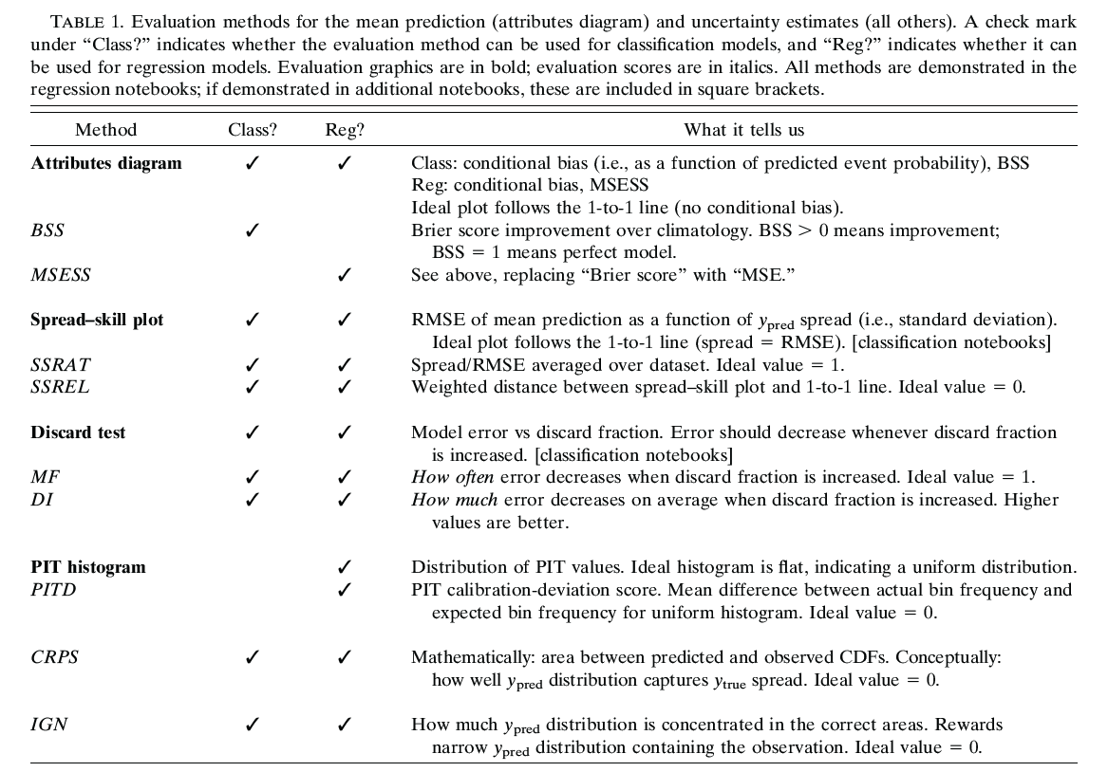

Slide 21
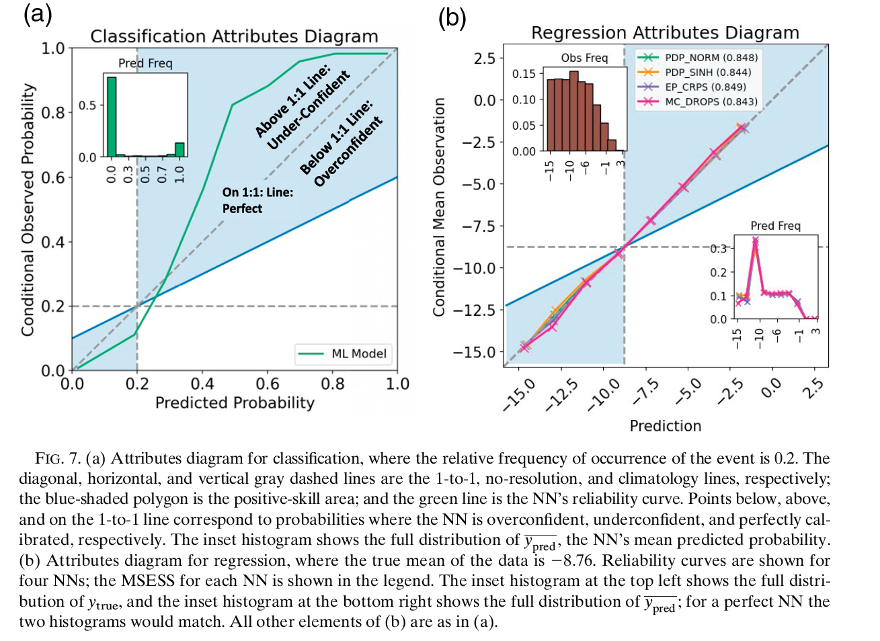

Slide 22
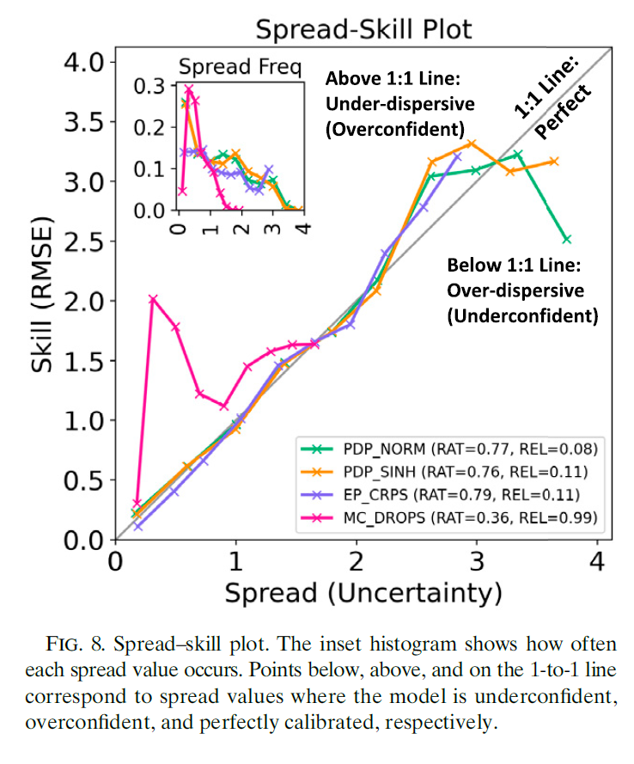
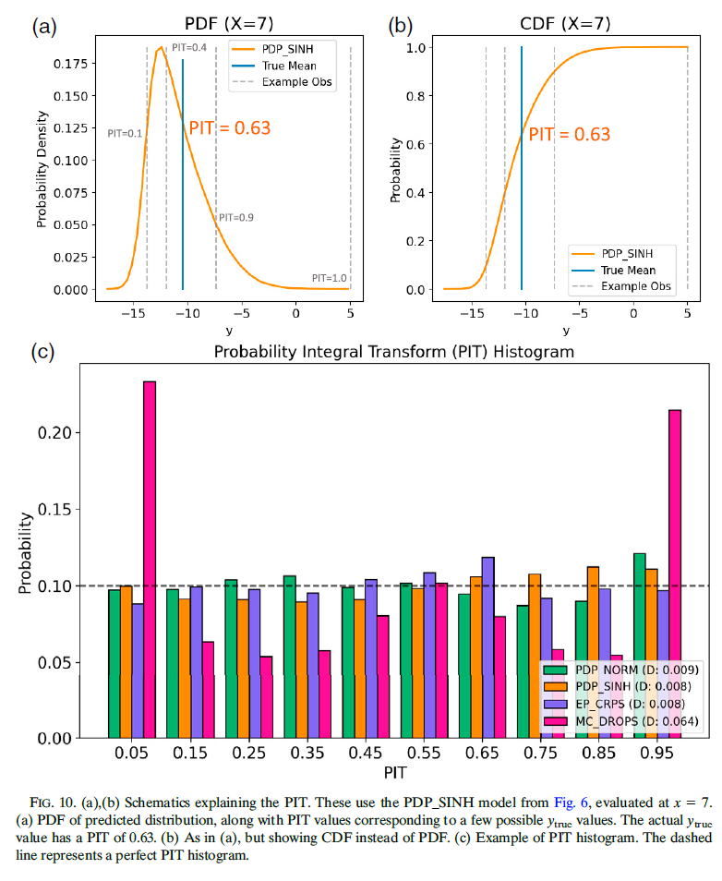

Slide 23
